Slide 1


Space debris detection

Slide 2

PRESENTED BY:
RAMEZ MILAD
HASSAN ANEES
MOTAWAE MOHAMED
IBRAHIM WAGEH
SUPERVISED BY:
DR. MAHMOUD FARAG

Slide 3
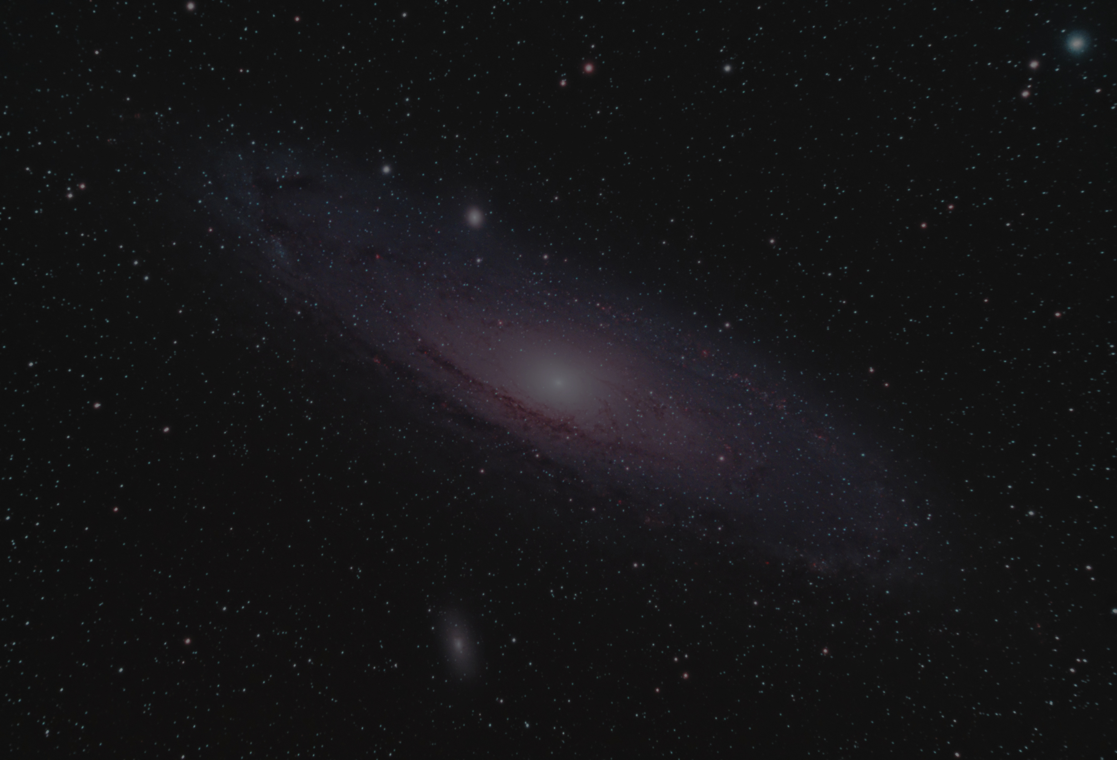




TIMELINE
DATASETAND FEATURES
HYPERPARAMETERS
INTRODUCTION
ACCURACY & LOSS
LIBRARIES & METHODS

Slide 4
TIMELINE
CONCLUSION
PROJECT PROBLEMS

Slide 5
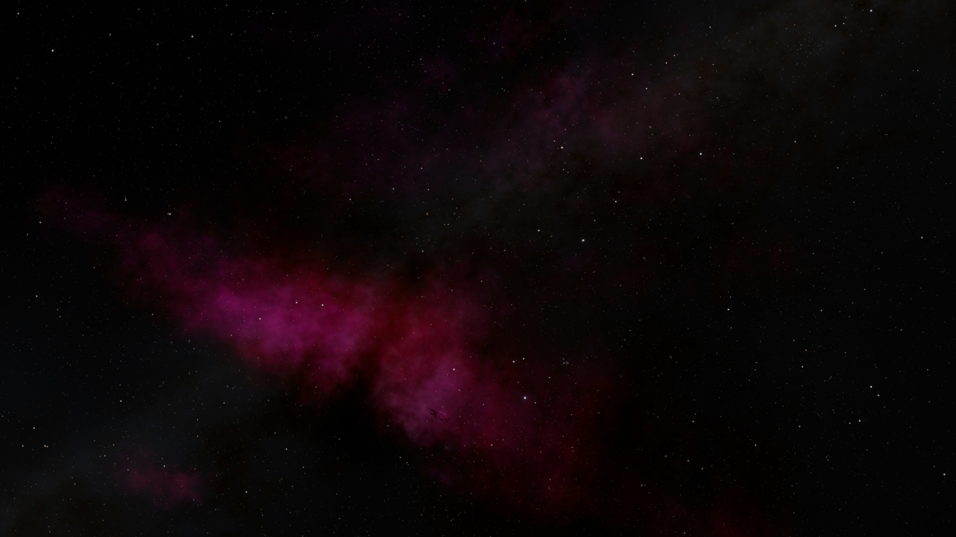
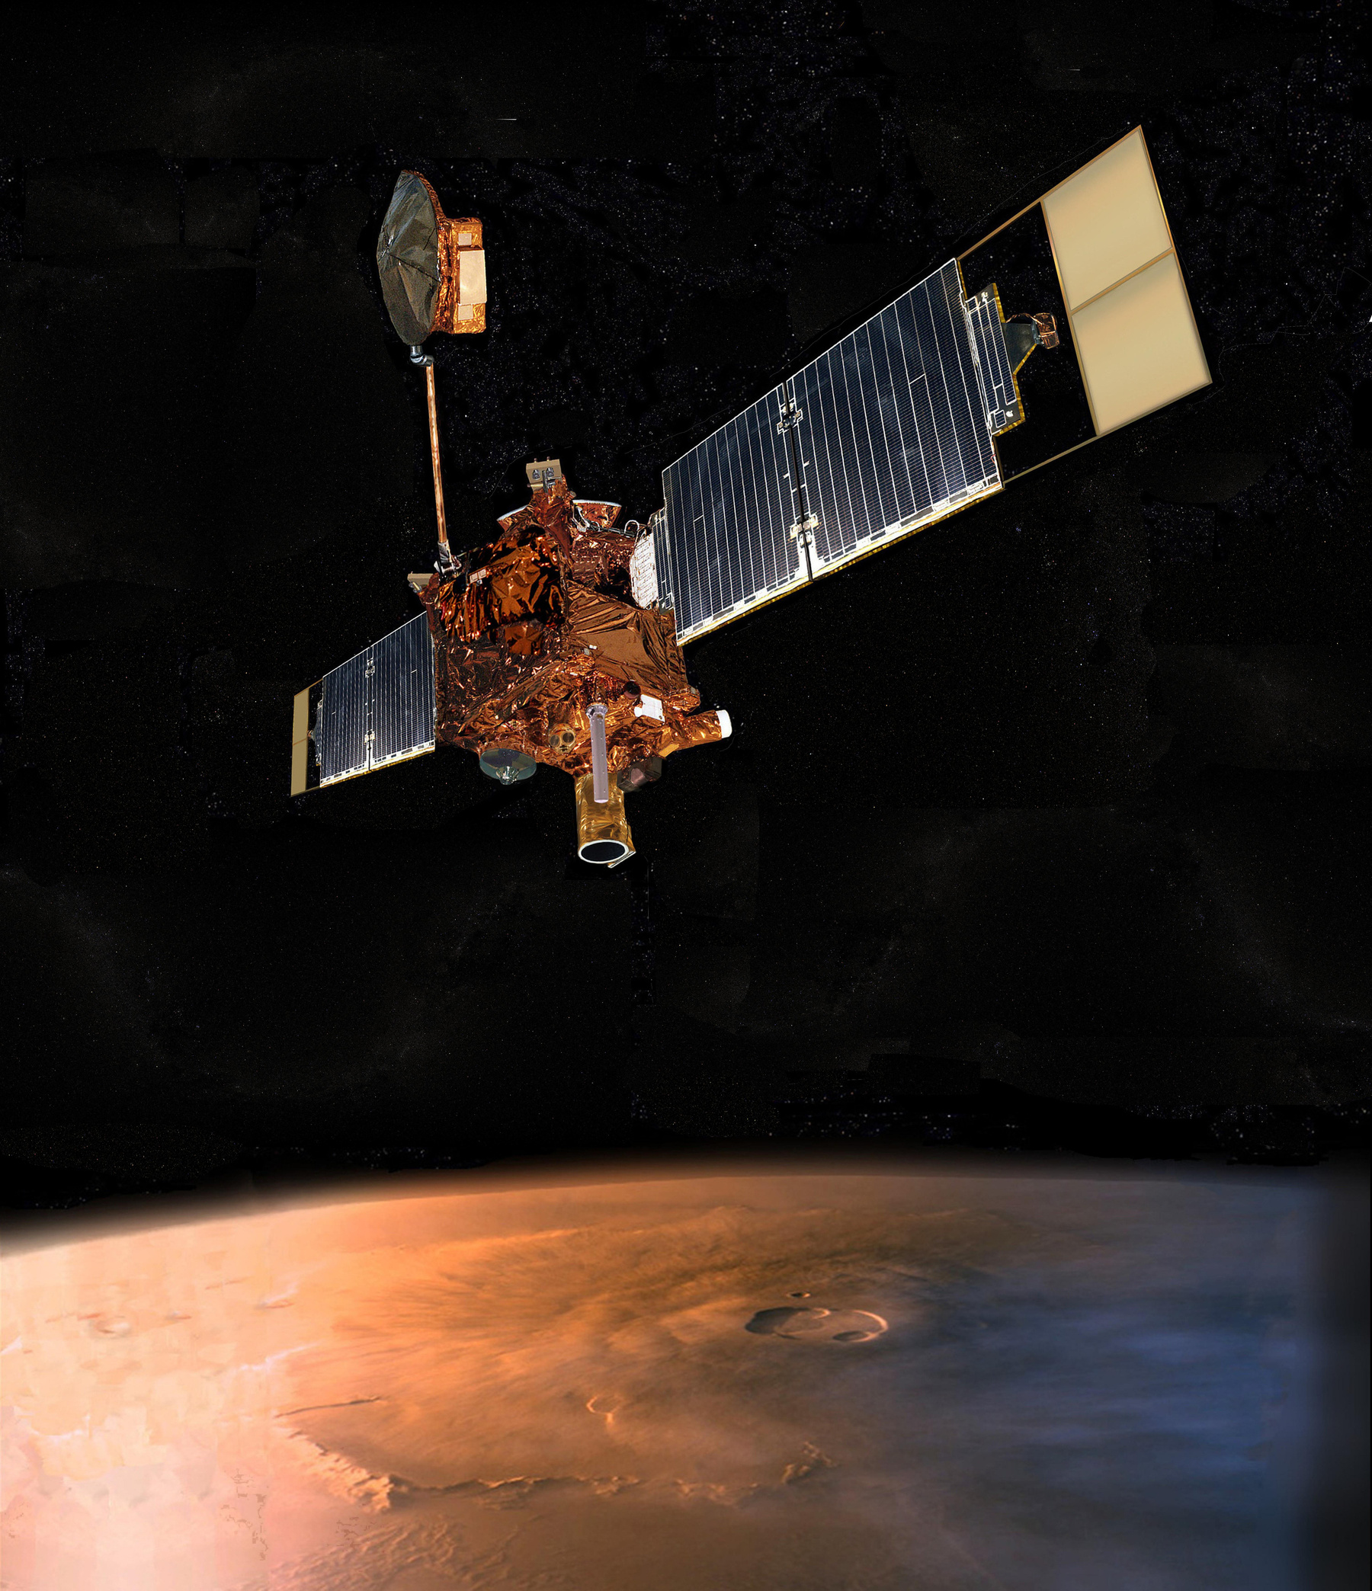
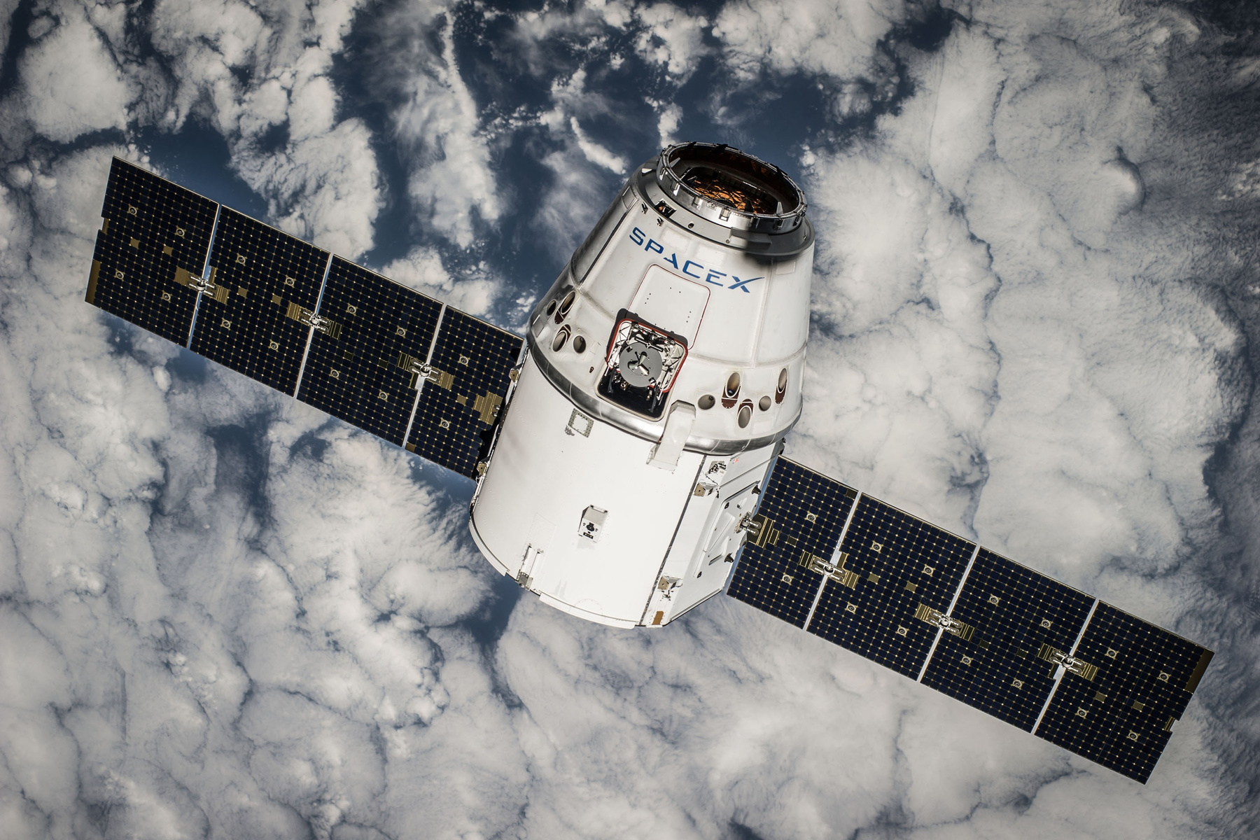

INTRODUCTION
Space debris has become a growing problem in Earth's orbit over the past century. It includes broken satellite parts, old, unused satellites, discarded rocket stages, tiny paint chips, and even frozen fuel droplets. According to NASA, there are over 27,000 tracked pieces of debris in orbit, but millions of smaller, untracked fragments also exist. These objects travel at speeds of up to 28,000 km/h (17,500 mph), fast enough to damage or destroy active satellites and spacecraft.
Due to their high speeds, even small debris can damage satellites, leading to chain reactions of collisions. The diverse shapes and sizes of space debris make detection challenging using conventional methods.
This project explores how deep learning can help track and detect space debris more effectively. Small satellites equipped with cameras and sensors could be used to locate and monitor debris, improving space safety. Better tracking would help space agencies predict potential collisions and protect satellites. In the future, AI-powered systems could even assist in capturing and removing space junk to keep Earth's orbit clear and safe.

Slide 6
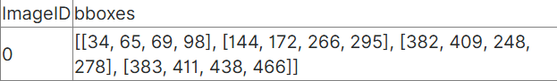
💾 DATASET
dataset contains images of space with space debris. The images are of size 256*256 in jpg format. The bounding boxes are in bboxes with the columns as ImageId and bboxes0 containing list in [xmin, xmax, ymin, ymax] format.
A SAMPLE ROW
The boxes will be in the string but to convert them into a python list, you can simply use literal_eval function from ast python library!

Slide 7





TRAIN
(20000 samples) This csv file contains the ImageID column corresponding and bboxes the column contains bounding boxes in a list.
📁 DATA SPLITTING
VAL
(2000 samples) This csv file contains the ImageID column corresponding and bboxes the column contains bounding boxes in a list.
TEST
(5000 samples) This zip file contains space with debris images which will be used to evaluate the performance of the model.

Slide 8
LIBRARIES
MAIN LIBRARIES
The main libraries used in this project is :
Detectron2 : Object detection framework for Faster R-CNN.
Open CV : Image processing, loading images, and drawing bounding boxes.
PyTorch
Pandas
Numpy
Matplotlib
TensorBoard : Visualizing training loss, accuracy, and performance.

Slide 9
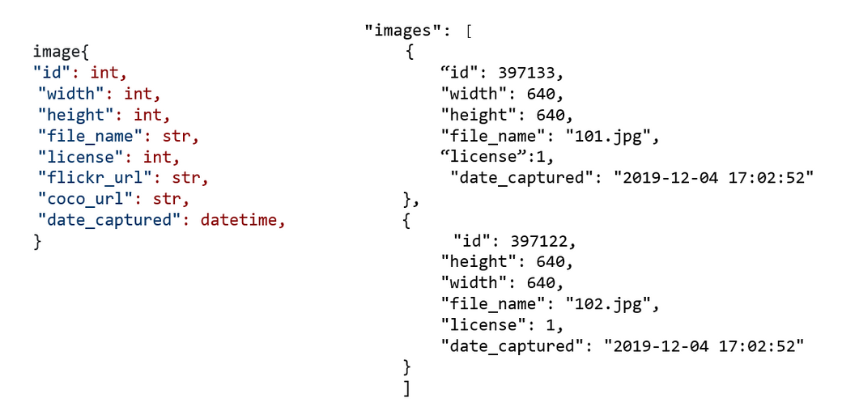
LIBRARIES
DETECTRON2
Various libraries were used for this project but the main library is Detectron2 made by Facebook specially for object detection which makes it the suitable library,It is built on PyTorch and provides pre-trained models for tasks like object detection, instance segmentation, keypoint detection, and panoptic segmentation. Detectron2 is optimized for speed, flexibility, and scalability, making it ideal for training custom object detection models with datasets in COCO format

Slide 10
LIBRARIES
KEY FEATURES FOR DETECTRON
Provides pre-trained models for transfer learning.
Uses GPU acceleration for fast training and inference.
Supports custom datasets and COCO-style annotations.
Supports Faster R-CNN Algorithm for lower training time and higher accuracy.

Slide 11
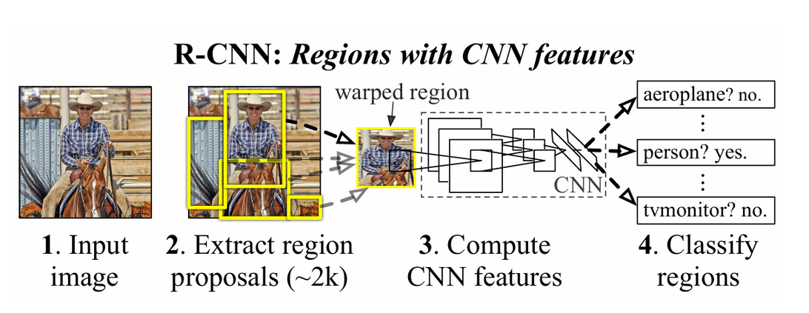
METHODS
R-CNN MODEL
R-CNN (Regional Convolutional Neural Network) is a deep learning model for object detection that uses a two-step process:
Region Proposal – Selects potential object locations using Selective Search and propose them as regions.
CNN Feature Extraction & Classification – Uses a Convolutional Neural Network (CNN) to classify each proposed region and refine bounding boxes.

Slide 12
HYPERPARAMETERS
TRAINING HYPERPARAMETERS
Batch size per iteration (number of images processed at once)
Initial learning rate (controls step size for weight updates).
Total training iterations (defines how long the model trains).
the model backbone (in this case ResNet 50)
model depth which is how many hidden layers in the network (in this case 50)

Slide 13
ACCURACY & LOSS
ACCURACY
Detectron2 evaluates model performance using COCO evaluation metrics, which include:
mAP (Mean Average Precision) : Measures overall accuracy across different Intersection over Union (IoU) thresholds (strictest metric).
AP@50 (AP at IoU ≥ 50%) : Measures accuracy when predictions overlap at least 50% with ground truth.

Slide 14
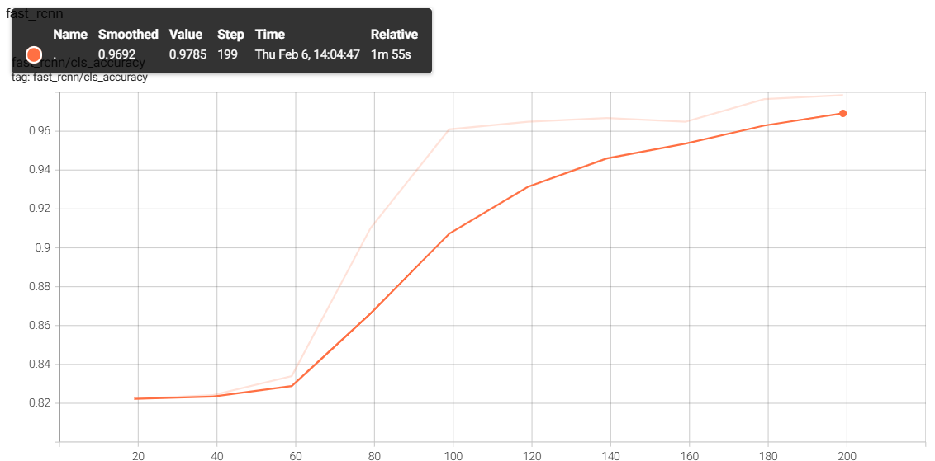
ACCURACY & LOSS
ACCURACY
as shown in the figure the Accuracy is 97.85.

Slide 15
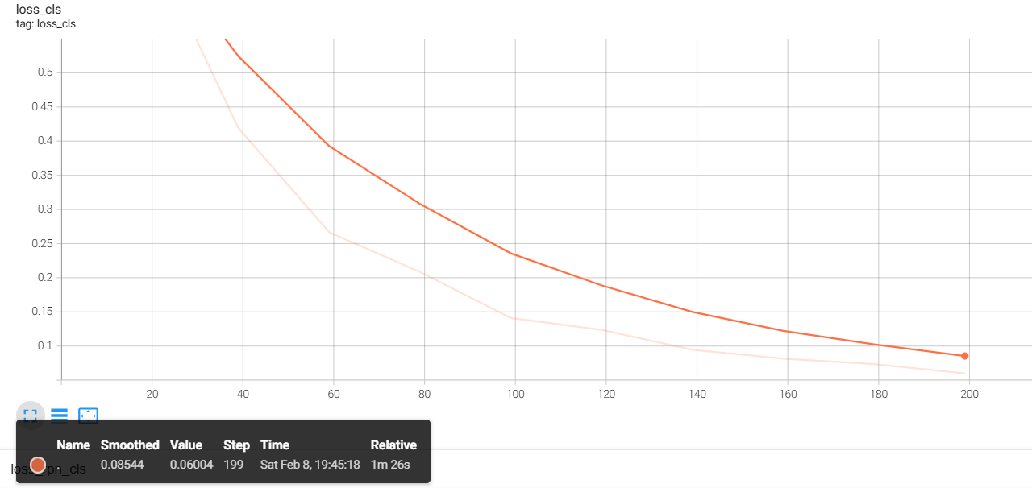
ACCURACY & LOSS
LOSS
as shown in the figure the loss is 0.06.

Slide 16



Slide 17
DETECTRON2 LIBRARY
FILE HANDLING
The main library we used for this project (Detectron2) was not able to run locally only on cloud (google colab)
google colab didn’t accept the images at first and we had to use the api and unzip the files manually
PROBLEMS WE FACED
REAL-TIME DETECTION
we couldn’t deploy a real time detection for the project as cloud platforms do not support it so we wrote a function to take a photo and predict on it.

Slide 18

CONCLUSION
In this project, we developed a space debris detection system using Faster R-CNN and Detectron2, demonstrating how AI can help identify and track debris to prevent potential collisions. Our model continuously improved, as reflected in the decreasing classification loss, AI-driven solutions like this are crucial for ensuring safer space operations, protecting satellites, and contributing to long-term sustainability in space exploration.

Slide 19
THANK
YOU

